Slide 1
Basic Mechanical Engineering
Ramu Rajendran

Slide 2
Additional Parts of a Petrol Engine
Carburetor – Device to mix desired quantity of fuel into the air stream to obtain a homogenous air-fuel mixture.
A good carburetor mixes the air-fuel in the desired mixture ratio in all the running conditions.
The basic principle used in the working of carburetor is that, when a volatile fuel is placed in the passage of a high velocity air stream, the fuel gets vaporized at a faster rate.

Slide 3
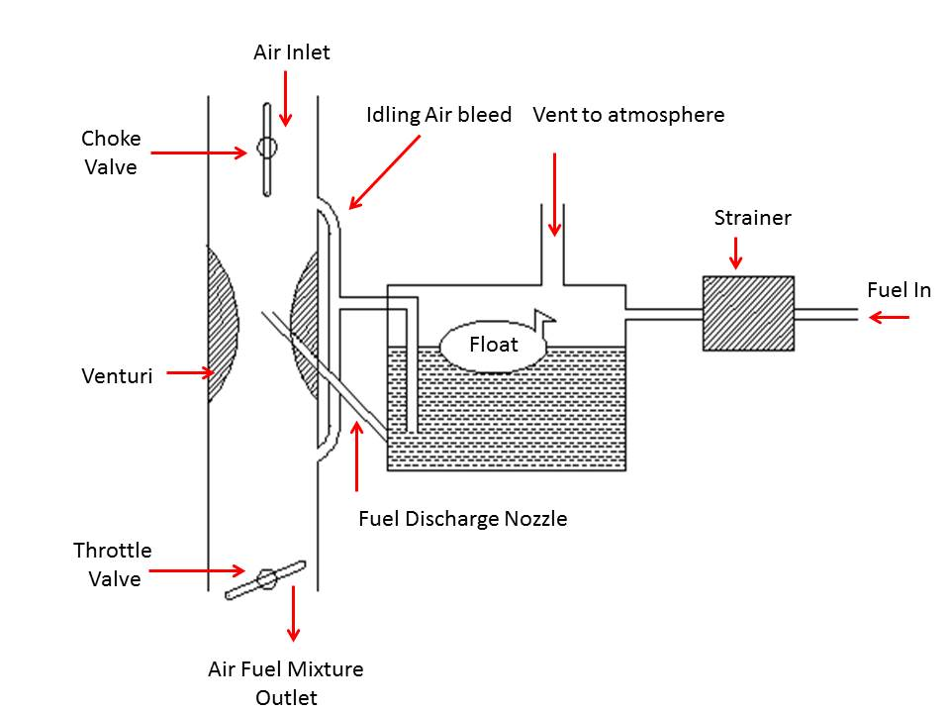
Carburetor (Understand Only)

Slide 4
Low Pressure Fuel Pump – Used to pump fuel from storage tank to the carburetor.
Spark Plug – Device used to generate spark to ignite the fuel-air mixture in the cylinder. Spark is produced by providing an air gap between two electrodes.

Slide 5
Additional Parts of a Diesel Engine
Fuel Injector – Device used to inject fuel into the cylinder in the form of fine spray.
High pressure fuel pump – Device used to supply measured quantity of fuel at high pressure to the injector.

Slide 6
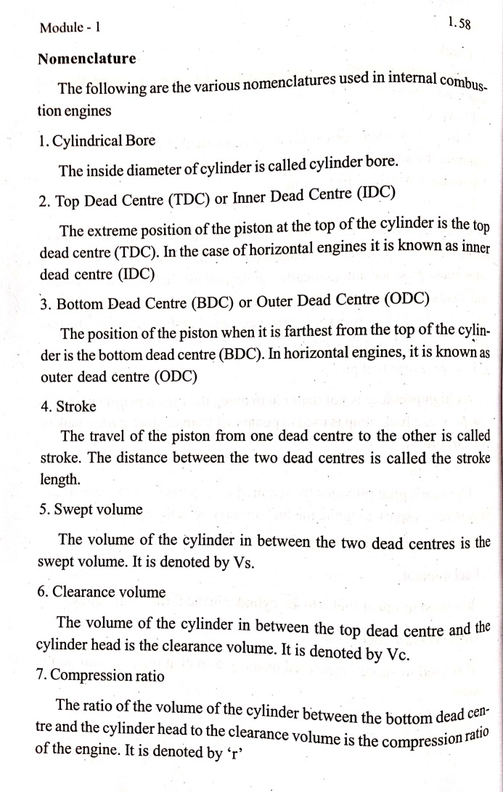

Slide 7
Classification of IC Engines
Based on Ignition System – SI and CI Engines.
Based on type of fuel used – Gas Engines, Petrol Engines, Diesel Engines and Dual-Fuel Engines.
Based on Working Cycle – Otto Cycle, Diesel Cycles, Dual combustion cycles.
Based on no: of strokes – Four Stroke engines and Two stroke engines.

Slide 8
Based on application – Stationary Engines and Mobile Engines.
Based on cooling systems – Air cooled engines and Water cooled Engines.
Based on speed of the engine – Low speed (<350rpm), Medium speed and High speed Engines (>1000rpm).
Based on no: of cylinders – Single cylinder and Multi cylinder engines.
Based on cylinder arrangements – Vertical, Horizontal, In-line, V-engines, Radial engines, Opposed cylinder engines etc.

Slide 9
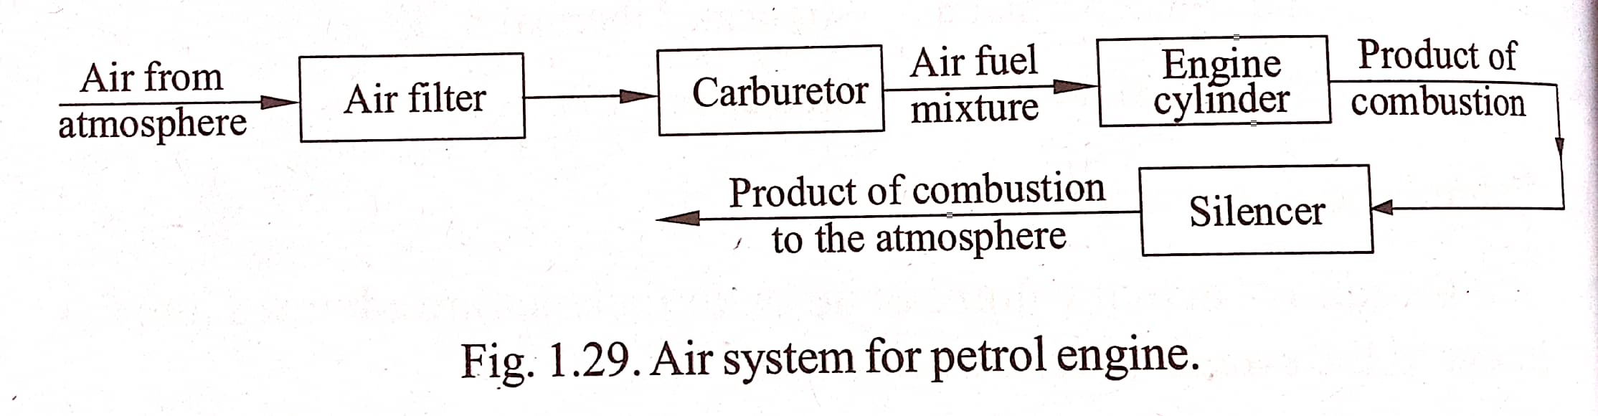
Air system for a petrol Engine

Slide 10
Air provides oxygen for combustion.
Air is cleaned in air filter and then is mixed with fuel in the carburetor.
The air-fuel ration by weight should be about 15:1 for complete combustion.
But there is a range of air-fuel ratio from about 8:1 to 20:1 for different running conditions.
More air means – Lean mixture. More fuel means – Rich mixture.
The air-fuel from carburetor enters engine through the inlet valve and then after combustion flows out of the exhaust valve and silencer to atmosphere.

Slide 11
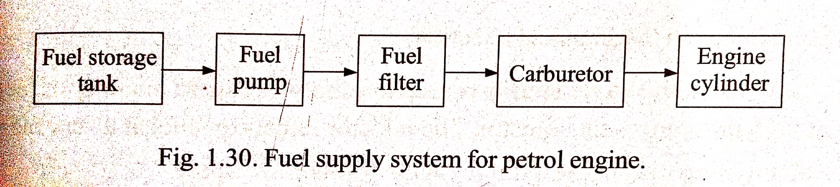
Fuel System for Petrol Engine

Slide 12
The fuel stored in the tank is transferred to the carburetor using a low pressure fuel pump.
If the fuel tank is placed at a higher level, then the force of gravity may alone be required to transfer fuel to carburetor. In that case pump is not required.
Before entering the carburetor the fuel is cleaned by passing through a fuel filter.
After mixing with air in the carburetor fuel is moved towards the engine cylinder where combustion of fuel takes place in the presence of oxygen in the air.
The products of combustion the moves out of the engine cylinder to the atmosphere.

Slide 13
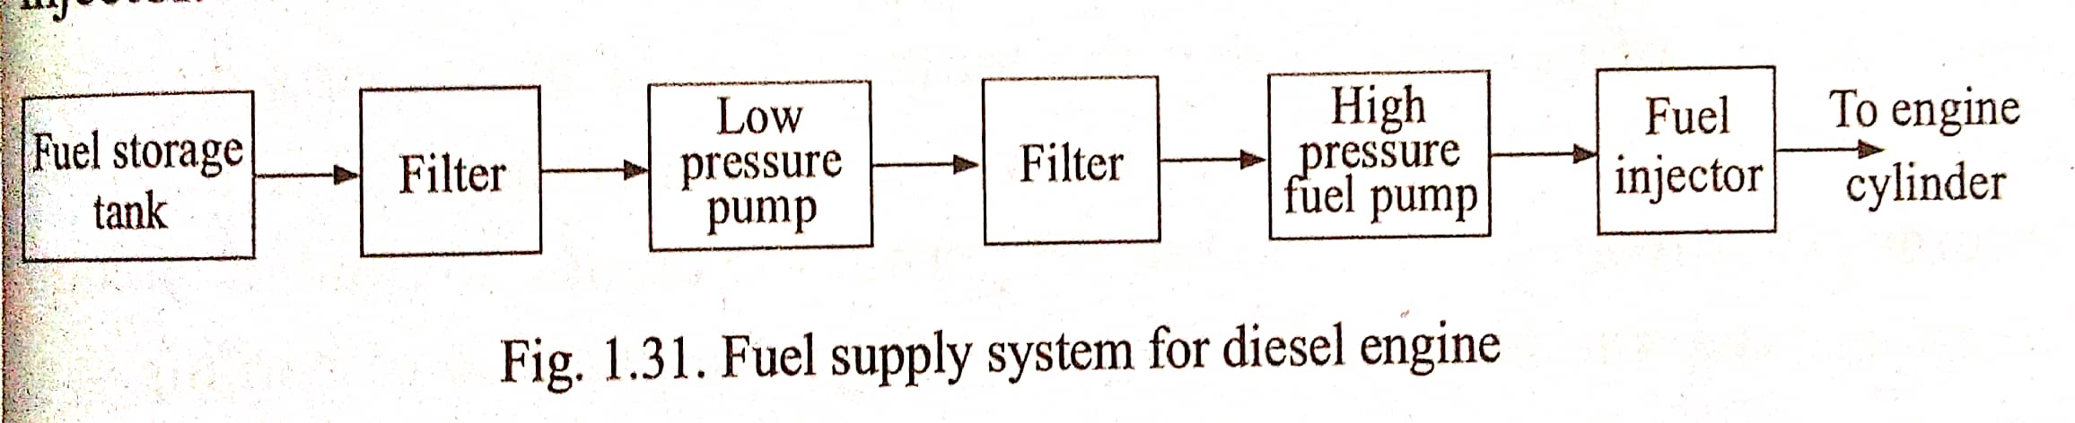
Fuel System for Diesel Engine

Slide 14
From fuel storage tank a low pressure pump takes the fuel to a high pressure pump. In between fuel is cleaned using fuel filters.
High pressure pump is required because - to spray fuel into air inside cylinder at high pressure, the fuel should be at an even higher pressure.
The fuel from the high pressure pump is then injected into the engine cylinder using a fuel injector, at high velocity in the form of fine spray.

Slide 15
Cooling System
About 30% of heat generated is absorbed by the engine parts (piston, cylinder head and cylinder wall).
If the heat is not removed, this will cause excessive rise in the temperature and damage the parts. Also due to thermal expansion piston gets stuck in the cylinder
Max temp of the cyl. wall should be 250 deg C.
Therefore a cooling system is required to keep the engine from becoming too hot.
Two types of cooling systems are in IC engines – a) Air Cooling and b) Liquid Cooling (Water Cooling)

Slide 16
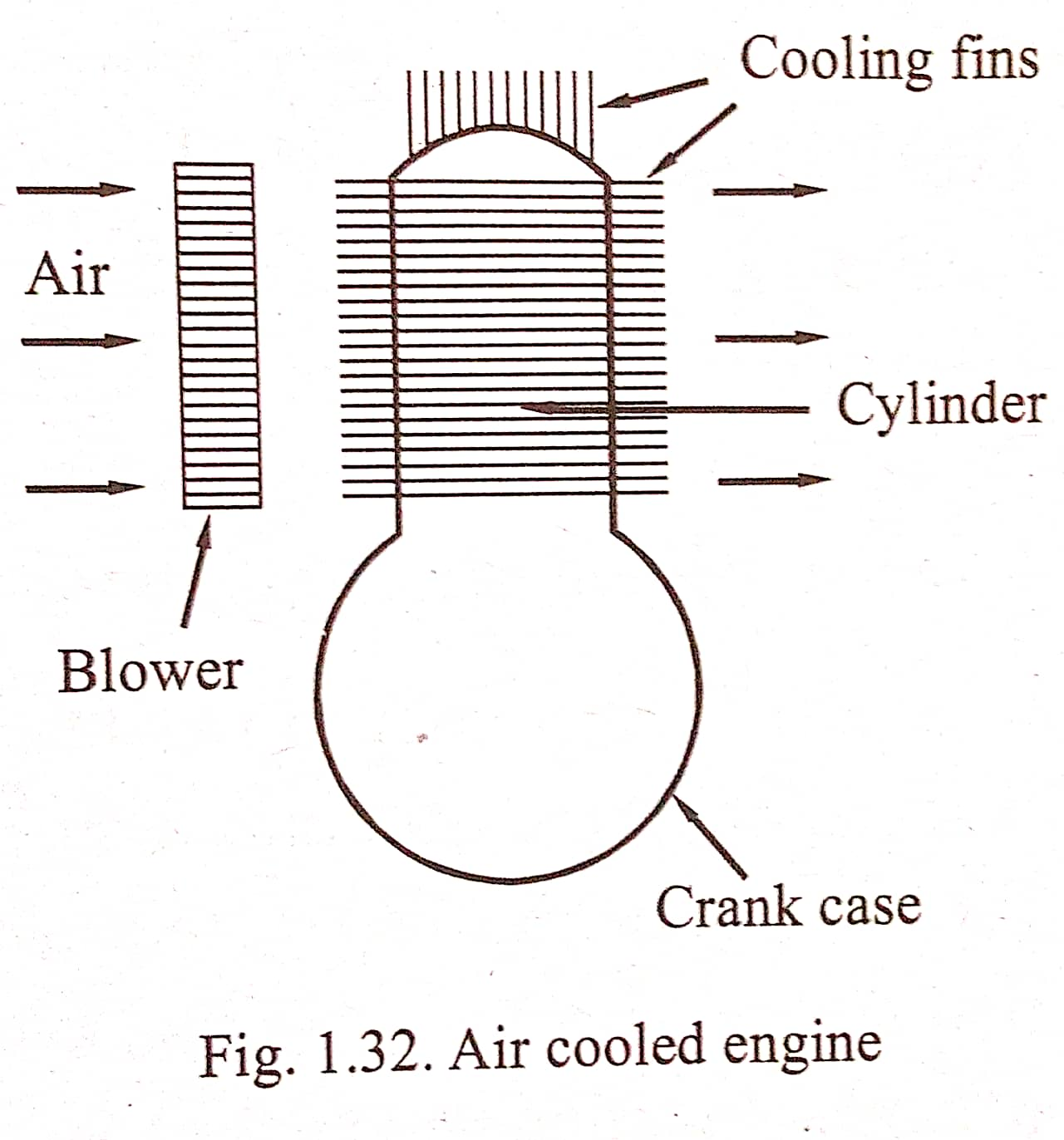
Air Cooling

Slide 17
Heat is directly dissipated into the air around the cylinder.
A current of air is continuously flows over the heated surface to be cooled.
Used in motor cycles, airplane engines and small stationary engines.
Fins are provided on the outer surface of the engine to increase the area exposed to air.
In some cases blower may be used to increase the flow of air. In mobile engines forward velocity helps in the air velocity.
Advantages – Simplicity, Lightness, Cheapness and Absence of water.
Disadvantage – Non uniformity in cooling, difficult to control the cooling rate.

Slide 18
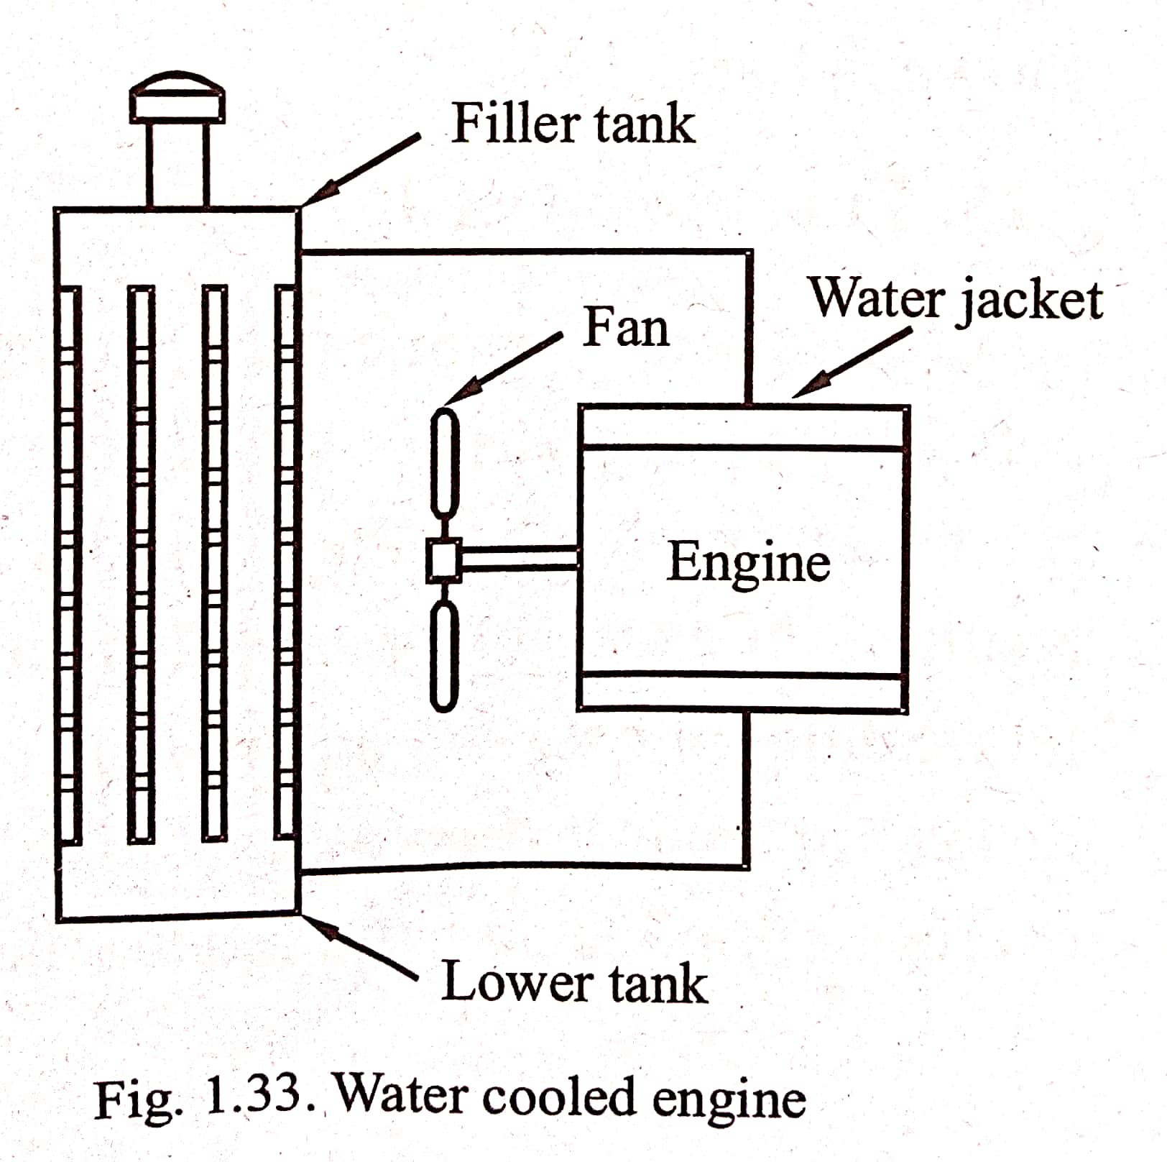
Liquid Cooling (water cooling)

Slide 19
Water is circulated around the components to be cooled through passages called water jackets.
Water circulation is obtained either by using a pump or gravity force.
The water from the jackets flow to a radiator. In the radiator the heated water gets cooled by an air flow caused by the forward motion of the automobile.
To increase the heat transfer area radiator tubes are provided with fins and air flow is increased by fans.
Radiator consists of an upper filler tank and a lower tank – The exit from the engine jackets is connected to upper tank and lower tank is connected to jacket inlet. (Hot water density is low and therefore flows at the top).
To avoid freezing in the extreme cold, some anti-freeze solutions are added to the water in radiator tubes.

Slide 20
Water cooling is classified as – natural or gravity circulation system and forced or open circulation system.
In natural circulation system, the change in density of water due to difference in temperature causes it to circulate in the system. It is known as thermo-syphon cooling system.
In forced system, water is circulate using a pump. In this a pump (which runs with power from engine) is used to draw water from a cooling pond and to circulate it through the engine jackets.

Slide 21
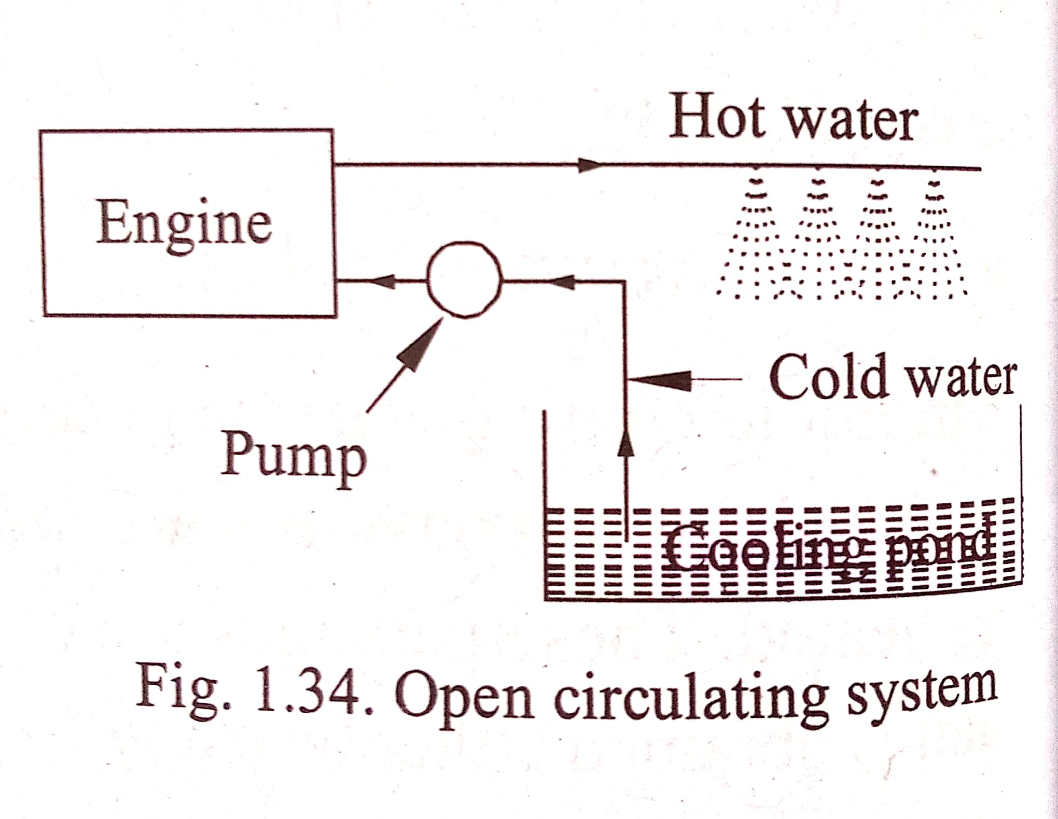

Slide 22
Lubrication of IC Engines
Lubrication is necessary to reduce friction.
Friction causes energy loss, heat generation and also excessive wear.
Friction can be reduced by placing a film of lubricating oil between the moving parts.
There are different types of lubricating systems.
1. Splash System – Simplest type. There is an oil reserve at the base of the engine. When the connecting rod moves up by some mechanism, it splashes the oil in the form of a spray. The internal parts of the engine are lubricated by this oil spray. This type is employed in some type of small single cylinder stationary engines and on engines employed in scooters.

Slide 23
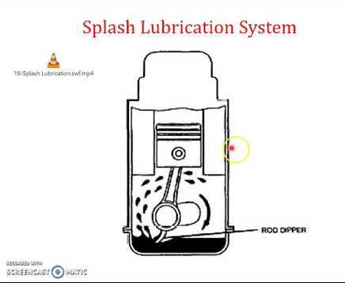

Slide 24
2. Splash and Circulating system – In addition to splash system there is an oil pump to refill the reservoir with oil.
3. Splash and pressure system – Splash system plus an oil pump which supplies oil to the reservoir and also to the parts not lubricated by the splash system.
4. Forced feed system – Oil is forced by an oil pump through designed oil passages to all the components needed to be lubricated. Most of the present day engines are lubricated by this type.

Slide 25
Lubricant
Desirable Properties – *Should maintain sufficient viscosity under all ranges of temperature. * Must not vaporize in its operating temperature. *Should have high specific heat to remove heat generated. *Must be free from corrosive acids, moisture etc. *Should have considerable adhesive property to cling onto metal surface *Should have good cohesive quality to form a continuous film between rubbing surfaces.
Function – *Remove heat from the parts it comes in contact with. *Keep the metal surfaces apart and prevent friction and wear. *Seal the space between piston rings and cylinder walls and thus prevent leakage of working gas. *It must also clean the metal parts it comes in contact with and hold the dirt, metal or carbon particles.

Slide 26
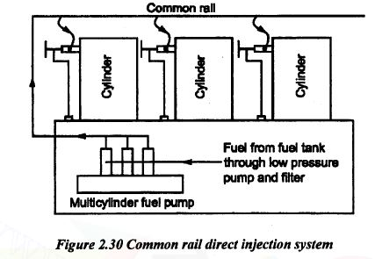
CRDI (Common Rail Direct Injection)

Slide 27
For Diesel Engines
In CRDI, an extremely high pressure pump stores a reservoir of fuel at high pressure of 200 MPa, in a common rail.
Common rail is a tube which branches off to computer controlled injector valves.
Each of these valves has a precision machined nozzle and a plunger driven by a solenoid.
Controlled by a computer, the valves control the precise moment, increased pressure and amount of fuel to the pump.
As a result the injected fuel atomizes easily and burns cleanly, reducing exhaust emissions and increasing efficiency.
To reduce the vibration and noise the ECU can inject small amount of diesel just before the main injection. Some advanced CRDI systems perform as many as 5 injections per stroke to obtain a more uniform and controlled combustion and to extract maximum energy from combustion.
Different car makers refer to CRDI by different names – (BMW; D-Engines), (Honda; i-CTDi), (Hyundai; CRDi), (Mahindra; CRDe), (Maruti; DDiS), (Mitsubishi; DI-D), (Toyota; D-4D).

Slide 28
Advantages of CRDI
Higher efficiency due to variable injection timing.
Better combustion at low speeds.
Better power balance.
Less moving parts.
More compact engine.

Slide 29
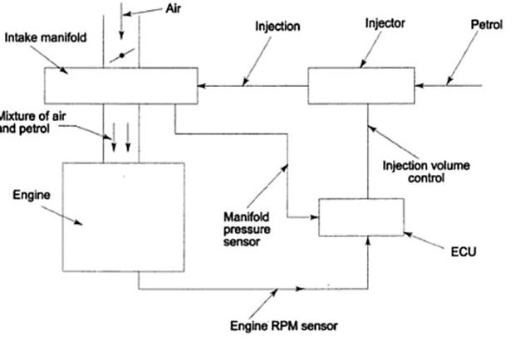
MPFI (Multi Point Fuel Injection)

Slide 30
For petrol engines.
Has one injector for each cylinder. (Multi – point injection)
Fuel is injected to the air flowing in through the inlet manifold based on commands from the ECU (Engine Control Unit).
ECU controls the ignition timing and quantity of fuel to be injected.
ECU is controlled program interpretation of data input from a set of sensors located all over the engine and its auxiliaries.
Parameters sensed are – ambient temperature, engine coolant temperature, exhaust gas temperature, oxygen content of the exhaust, engine speed, vehicle road speed etc.

Slide 31
Advantages of MPFI
The difference in power developed in each cylinder is minimum.
Vibration of the engine is less.
Immediate response to sudden acceleration and deceleration.
Since accurate amount of fuel is supplied, complete combustion takes place. This leads to effective utilization of fuel supplied and hence low emission level.
Mileage of the vehicle is more.

Slide 32
HYBRID ENGINES
Vehicles that makes use of two or more distinct power source are known as hybrid vehicles.
Usually they come with a fuelled power source and an onboard rechargeable energy storage system for powering the vehicle.
Since braking is controlled by electric motor to some extend, a part of the kinetic energy of the vehicle is recaptured and is used to recharge the batteries. The process is called regenerative braking.
Based on extend of use of battery power source there are 4 types of hybrid vehicles.

Slide 33
Types of Hybrid Vehicles
Mild Hybrid – Electric system will not propel the wheels. But will only assist the IC engines in power demanding operations like starting, acceleration and operation of AC etc. Batteries cannot be plugged in. They are charged by power from IC engines and through regenerative braking.
Full Hybrids – Similar to Mild Hybrids, but the electric systems can handle more heavier duties like propelling the vehicles at low speed city drives. Battery/motor is powered from IC engines and through regenerative braking (Cannot plug-in). Two types: parallel hybrid and series hybrid.

Slide 34
Parallel Hybrids can propel the vehicle by either of 3 ways: Directly by IC engine, Directly by electrical motor or by combined IC engines and electric motor together.
Series Hybrids are propelled by electric motor only. The IC engines power the electric motor (and also charges the battery) like a generator.
Plug-in Hybrids – The batteries can be charged by plugging in. Therefore, this type have a higher electric-only driving range than full hybrid types. These types are half way points between full hybrid and fully electric vehicles.

Slide 35
Electric vehicles with range extender hybrids – Essentially, an electric vehicle. But incorporates a small IC engine to charge the battery or power the motor, in case the battery charge is finished during a drive.
(Fully electric vehicles with no IC engine do not come under Hybrid vehicle category)

Slide 36
Advantages of Hybrid Vehicles
Reduced petroleum consumption.
Higher efficiency due to regenerative braking.
Low pollution due to less fuel consumption.
Less noise due to substantial use of motor.

